Slide 1


IOT Based AGRICULTURE Control and
Irrigation
GOKUL DAS K
26

Slide 2

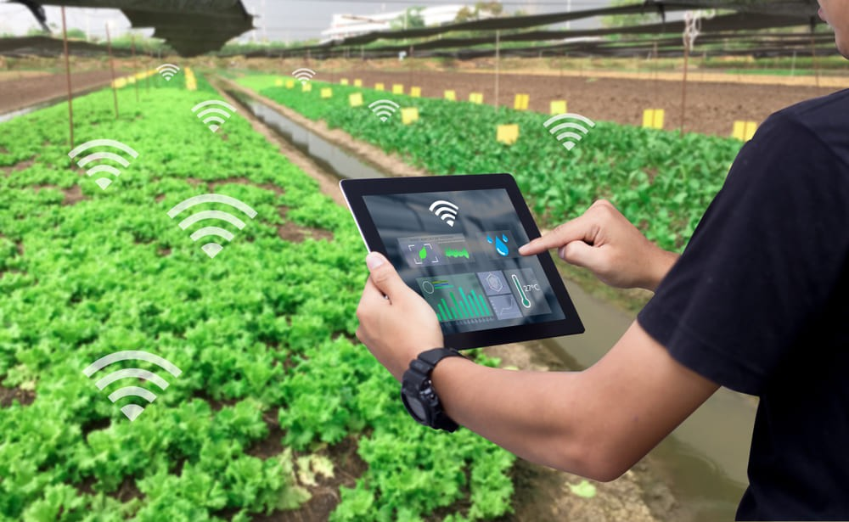
Introduction
The Internet of Things (IoT) has made a revolution in all the fields of human life by making the work be smart and effective.
The main idea of this paper is to propose the IoT based framework for the farmers by analyzing the live information like (moisture ,temperature) .
A greenhouse is a building or a house for plant growth. Using IoT modules and web servers, we can make this green house building a smart space.

Slide 3

Motivation
Monitoring of live condition of soil &
climate conditions
Get better yield and seamless management
01
02
Management of crops
using sensors
Adding of fertillizer and irrigating the field in optimum level
03
04

Slide 4

Literature Survey[1]
Intelligent management is must in the modern world, although energy supply systems tend to be regulated using traditional methods. It also involves workers tracking and collecting consumer data, which leads to human error
The GSM network uses this dual-way communication system to send SMS through the device interface and send information to user through SMS. Relay and LCD circuits are used to alter and display information such as current, devices, voltage and billing, or sudden GUI power outages for customers
In the event of a power supply voltage, our system may also send a warning to the energy supplier and automatically shut down the power supply until the power supply voltage has been corrected.

Slide 5
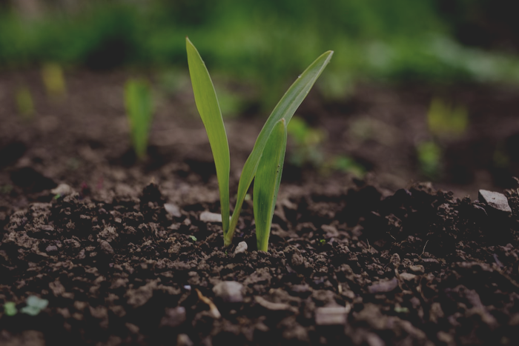

Literature Survey[2]
IOT technology has made it digital and interactive and has revolutionized all aspects of human life
The method offers IoT-based smart farm stick that enables farmers to get
streaming information’s to monitor the environment for smart farming and its
overall yield and quality
The proposed product will be tested with high accuracy to feed data of more than 98% in vibrant agricultural fields

Slide 6
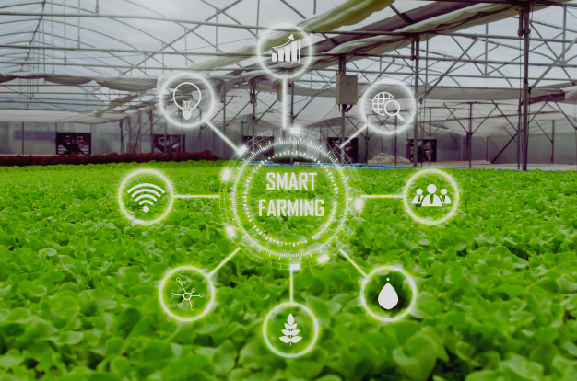
Problem
Humidity and temperature control is the key for suceess in farming
Improper management of humidity and temprature would affect leaf growth, photosynthesis, pollination, occurrence of diseases and finally economic yield.
In Traditional agriculture methods weather forecasting and rain detection is not possible

Slide 7

Proposed Method
The purpose of this article is to propose a new agriculture smart IoT device to help farmers to collect live environmental data(temperature, soil moisture) to monitor smart agriculture and increase overall yield
The Smart Farming Stick dependent on IoT contains the ESP8266 soil temperature and moistness checking framework and moves information to the cloud through the ESP8266 Wi-Fi module to thinkspeak
This IoT device computes 3 qualities: environment, soil moisture.This would also take into weather,rain update,live crop analysics into consideration

Slide 8
Proposed Method
Considering three input constrains of soil moisture ,temprature ,weather updates and present condition of crop fertilizers and irrigation pattern is formulated
This would act as a survalience system during night time and analyse the live crop during the morning time

Slide 9

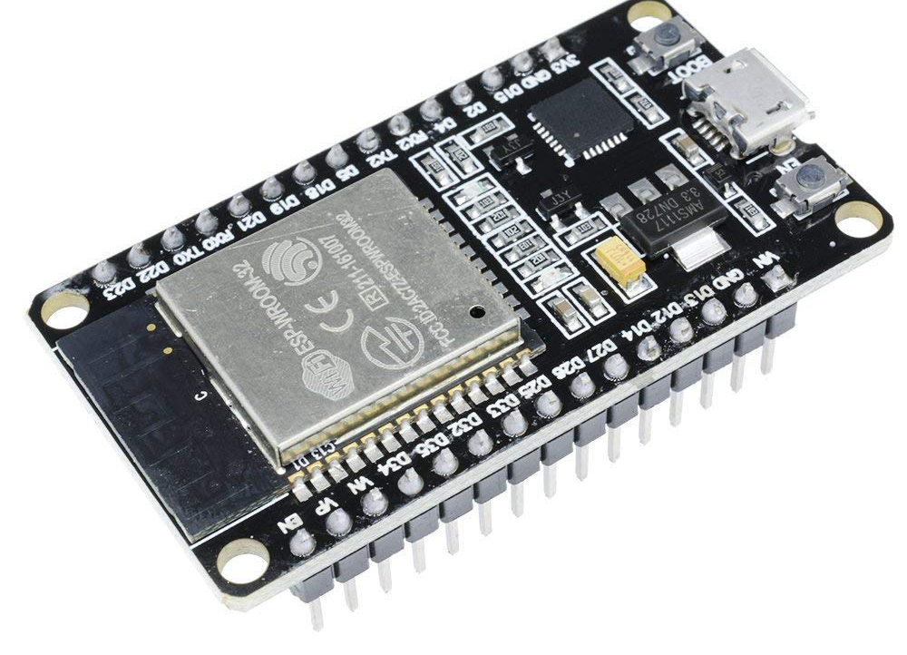
PROPOSED DESIGN
01
ESP 32 module
02
ds18b20 temperature sensor
03
ESP8266 Wi-Fi

Slide 10
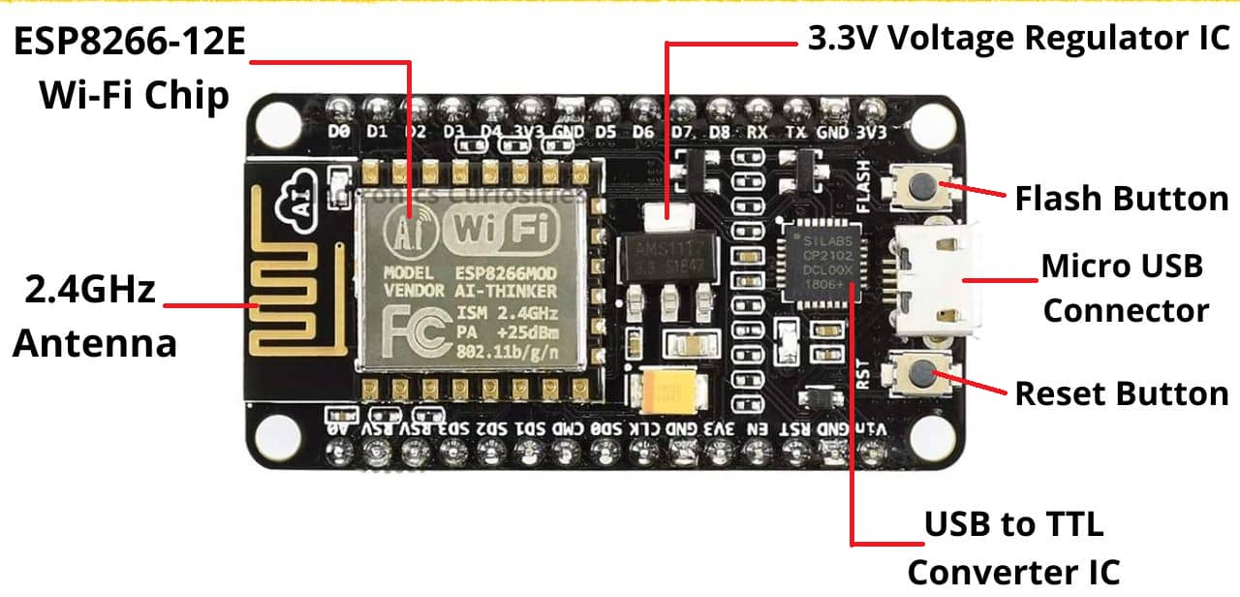
ESP8266
built-in 1 MiB
flash memory
connection via Wi-Fi
Open source IoT
Platform
The ESP8266 is a low-cost Wi-Fi microchip, with built-in TCP/IP networking software, and microcontroller capability

Slide 11
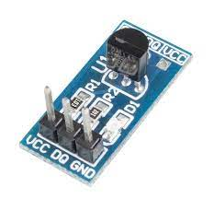
DS18B20 Temperature Sensor Module
Working Voltage: 3V~5.5V
Detected Temperature Range: -55°C~+125°C (-67°F~+257°F)
Pins
VCC: 3.3V-5V working voltage
DQ : data input/ output pin
GND: ground
DS18B20 digital temperature sensor works on a single bus and it has 64-bit ROM to store the serial number of component

Slide 12
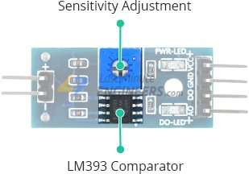
Soil Moisture Sensor
The fork-shaped probe with two exposed conductors, acts as a variable resistor (just like a potentiometer) whose resistance varies according to the water content in the soil.

Slide 13
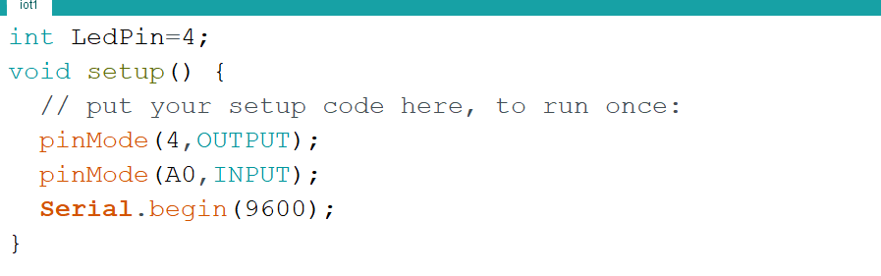
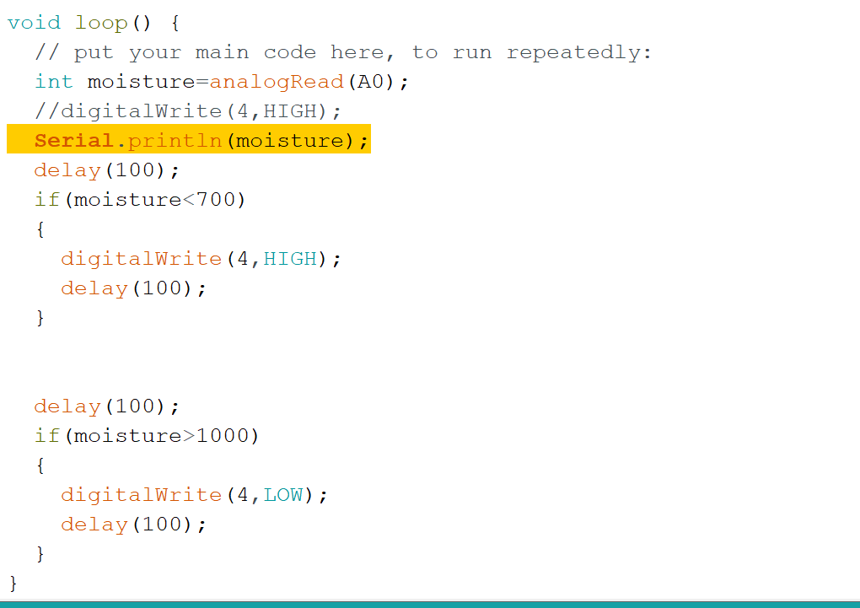

Slide 14
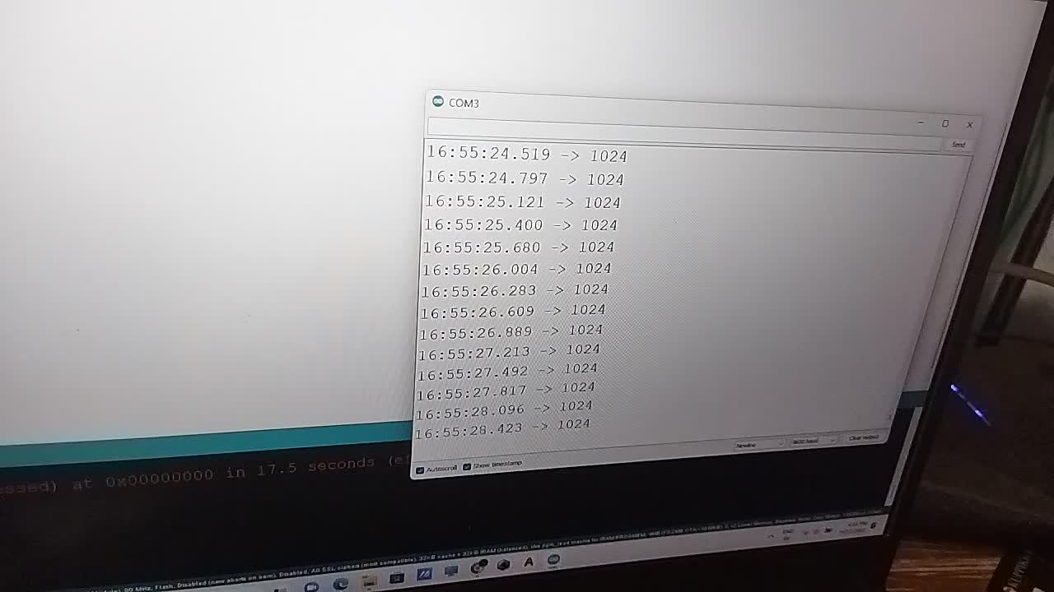

Slide 15

Experimental Results and Discussion
The different components are the following: GPS, Power supply unit, ESP8266, soil moisture, and
temperature sensor.
Here, the controller is used to connect all the components connected to the microcontroller.
The agricultural device is equipped with iot technology and can be accessed through online test boards with various sensors and live data transmissions through Thingsspeak.com. The sensors like temperature, soil moisture with cloud server

Slide 16


Future Scope
This System can be further modified by collecting and combining realtime robot in the feild and undergo ploughing seeding process also
ESP8266 wifi enabled module can be replaced with a specially designed board
which would make the system
more efficient and economical

Slide 17
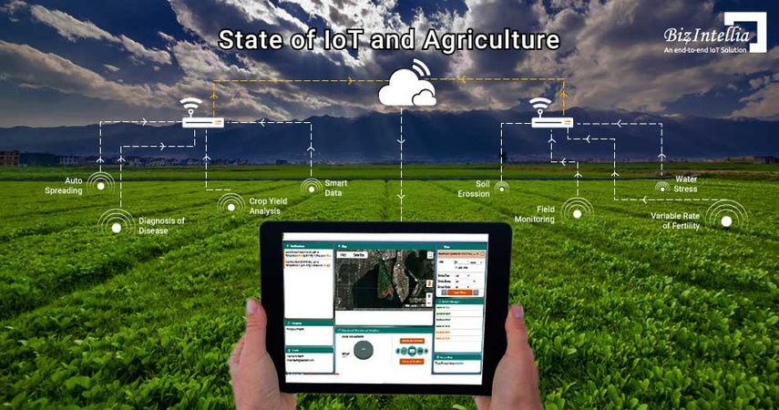
CONCLUSION
01
Agriculture stick using IoT will be used to support the farmers to monitor the data like temperature
and soil moisture, which results in an increase in food production.
03
The purpose of this article is to propose a new
Smart IoT to help farmers to collect live environmental data to monitor smart agriculture and increase
overall yield and product quality
02
The wireless monitoring of the farm using a temperature sensors and humidity sensors can be used to reduce
human power consumption

Slide 18
References
01
03
Tshali, D., Sumbwanyambe, M., &Hlalelef, T. S. (2018, April). Towards a GSM enabled
remote monitoring medical system. In 2018 3rd Biennial South African Biomedical Engineering
Conference (SAIBMEC) (pp. 1-4). IEEE.
Johnsen, F. T., Zieliński, Z., Wrona, K., Suri, N., Fuchs, C., Pradhan, M., ... &Krzysztoń, M.
(2018, May). Application of IoT in military operations in a smart city. In 2018 International
Conference on Military Communications and Information Systems (ICMCIS) (pp. 1-8). IEEE
02
02
Khan, N., Naseer, Y., Alam, I., Abbas, T., & Iqbal, Y. (2018, March). Wireless controlled smart
digital energy meter and theft control using GSM with GUI. In 2018 International Conference
on Computing, Mathematics and Engineering Technologies (iCoMET) (pp. 1-6). IEEE.

Slide 19

Thank You

